Slide 1
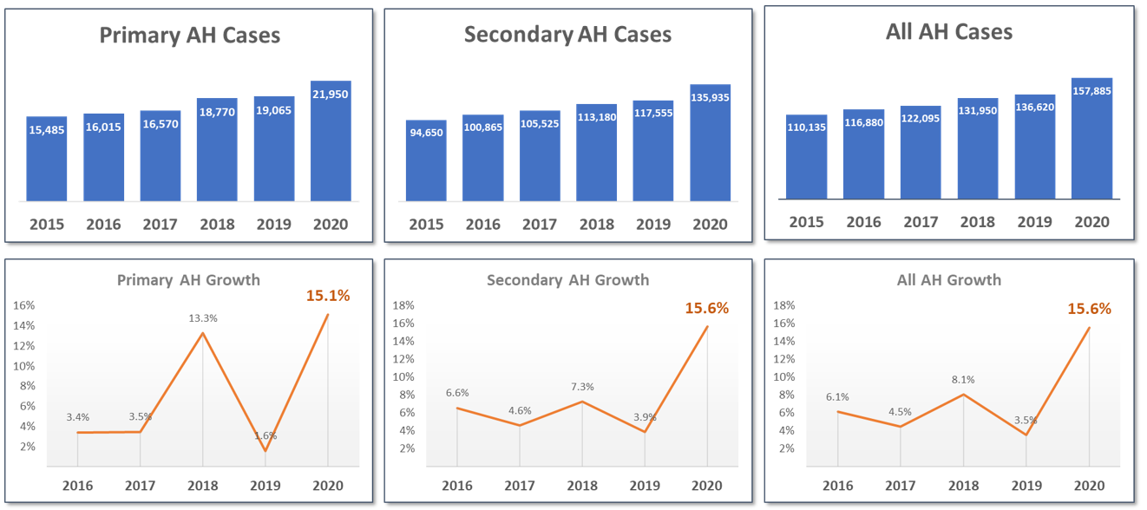
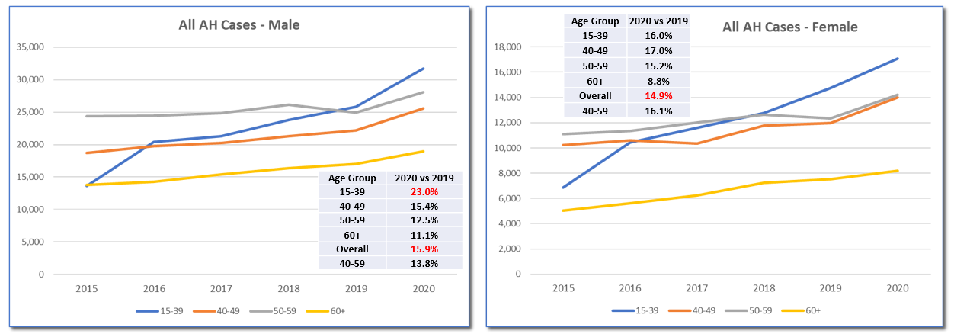
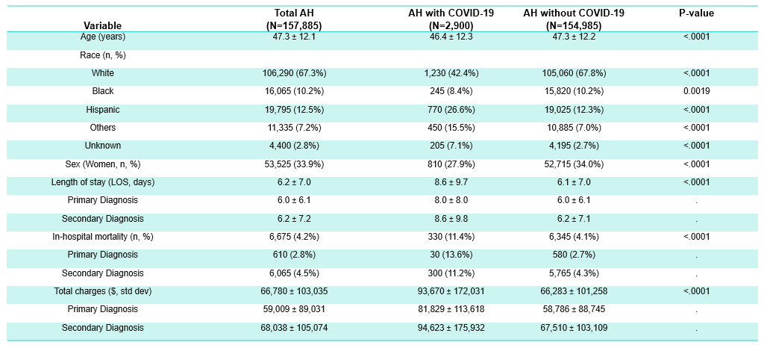
Epidemic within pandemic: Alcohol-related hepatitis and COVID-19
Natalie Marlowe¹, David Lam², Suthat Liangpunsakul³
¹DURECT Corporation, Cupertino, CA ²Pharma Analytics, San Anselmo, CA, ³Division of Gastroenterology and Hepatology, Department of Medicine, Indiana University, Indianapolis, IN
Introduction
RESULTS
Alcohol-related hepatitis (AH) is an acute, life-threatening form of alcohol-related liver disease (ALD), with 90d mortality rates up to 50% in severe AH.¹
We previously reported a steady increase in the total number of hospitalized AH patients in the US; approximately 5.5% annually between 2015 and 2019.²
Alcoholic beverage sales increased significantly during the peak of the COVID-19 pandemic in the US, accompanied by a rise in ALD cases. Little is known about the impact of SARS-CoV-2 infection among hospitalized AH patients.
In this study, we investigated the rate of AH hospitalizations in 2020 and impact of SARS-CoV-2 infection on AH patient outcomes and healthcare burden.
Figure 1. Hospitalized AH cases in the US from 2015-2020
Figure 2: Hospitalized AH cases in the US stratified by gender and age group
METHODS
We analyzed the US Nationwide Inpatient Sample (NIS) data from 2015-2020.
Patients with a primary or secondary diagnosis of AH were identified using ICD-10 codes K70.10 and K70.11.
We described associated comorbidities in AH patients with or without COVID-19.
The in-hospital mortality, length of stay (LOS), and hospital charges during the study period were compared for AH cases with or without COVID-19 .
Table 1. Baseline demographics, healthcare utilization, outcomes, and hospital charges
for AH cases with and without COVID-19 in 2020
ConclusionS
We documented a significant increase in AH hospitalizations, in-hospital mortality, and healthcare cost and utilization among AH patients, notably in those who were infected with SARS-CoV2.
Our results underscore an unmet and urgent medical need to identify effective therapies for hospitalized AH patients.
REFERENCES
RESULTS
Mathurin P, Bataller R. Trends in the management and burden of alcoholic liver disease. J Hepatol. 2015;62(1 Suppl):S38-S46.
Marlowe N, et al. (2022). Prevalence, co-morbidities, and in-hospital mortality of patients hospitalized with alcohol-associated hepatitis in the United States from 2015 to 2019. ACER, 46(8):1472-1481.
Deutsch-Link S, Jiang Y, Peery AF, et al. Alcohol-associated liver disease mortality increased from 2017 to 2020 and accelerated during the COVID-19 pandemic. Clin Gastroenterol Hepatology, 2022;20:2142-2144.
We observed a ~15.6% increase in hospitalized AH cases from 136,620 in 2019 to 157,885 in 2020, a significant increase from an average of 5.5% per annum (Figure 1).
Men younger than 40 was the fastest growing AH group, representing a 23% increase in 2020 (Figure 2).
SARS-CoV-2 infection significantly worsened the mortality among patients with AH (11.4% vs. 4.1%, p<0.0001), especially among older AH patients with concomitant comorbidities (Table 1).
Pneumonia (275% increase) and sepsis (50% increase) were the most common comorbidities in SARS-CoV-2(+) AH patients followed by GI bleeding (24%), ARF (37%), and HE (27.1%).
AH patients with COVID-19 had a longer length of stay (8.6 vs. 6.1 days, p <0.0001) and higher hospital charges during the stay ($93,670 vs. $66,283, p <0.0001).
CONTACT INFORMATION
Natalie.Marlowe@durect.com

